Slide 1
Forecasting Energy Consumption
Neeraj Tadur & Natasha Nath

Slide 2
Agenda
Background
Problem Statement
Data
Forecasting models
Model comparison metrics
Conclusion & Future Work

Slide 3
Background
Commonwealth Edison (ComEd) is the largest electric utility in Illinois and holds monopoly in Chicago and Northern Illinois area.
Provides electric service to more than 3.8M consumers.
They buy electricity in the competitive wholesale market

Slide 4
Problem Statement
Preempt the electricity demand in the region to make vital business decisions
Understand key drivers of power usage
Understand the role that seasonality plays

Slide 5
Data Overview

Slide 6
Dataset Specifications
Source & Description
Energy consumption
https://www.kaggle.com/robikscube/hourly-energy-consumption
Hourly power consumption for ComEd in MW
Hourly Weather data
https://www.kaggle.com/selfishgene/historical-hourly-weather-data
Hourly weather parameters which include Temperature, Pressure, Humidity, Wind Speed and Wind Direction for Chicago
Total dataset : January 1, 2013 - December 31, 2016
This analysis focuses on total energy used daily
Cleaning
Imputed data for missing temperatures and power consumption using kalman smoothing filter
Removed a single leap year data point to preserve annual seasonality

Slide 7
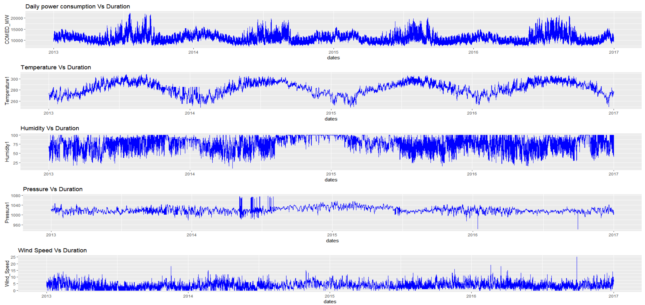
Time Series overview

Slide 8
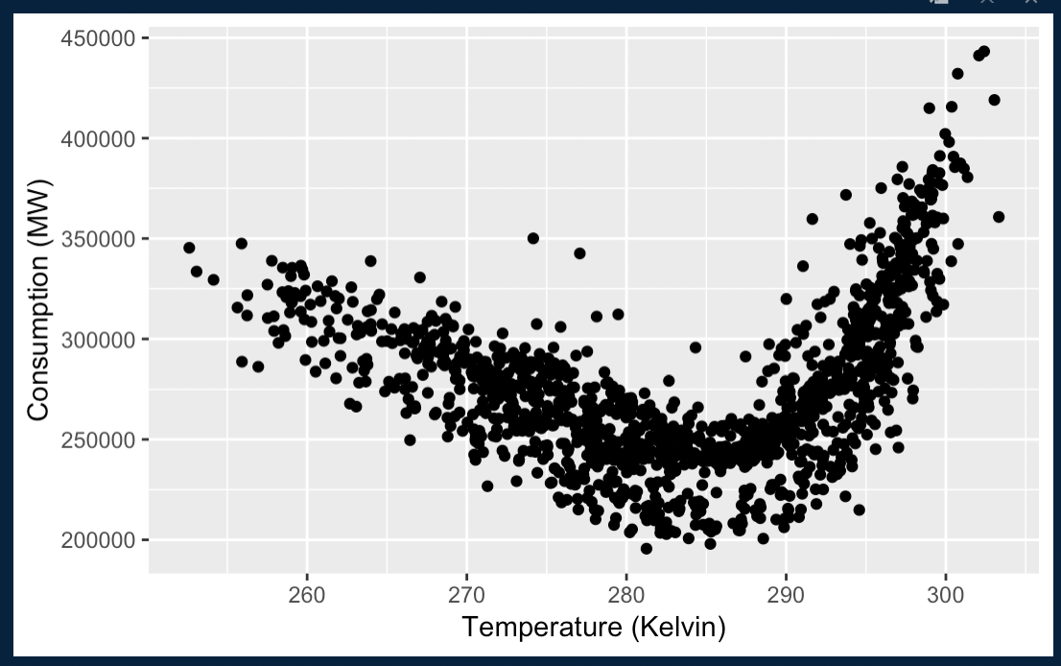
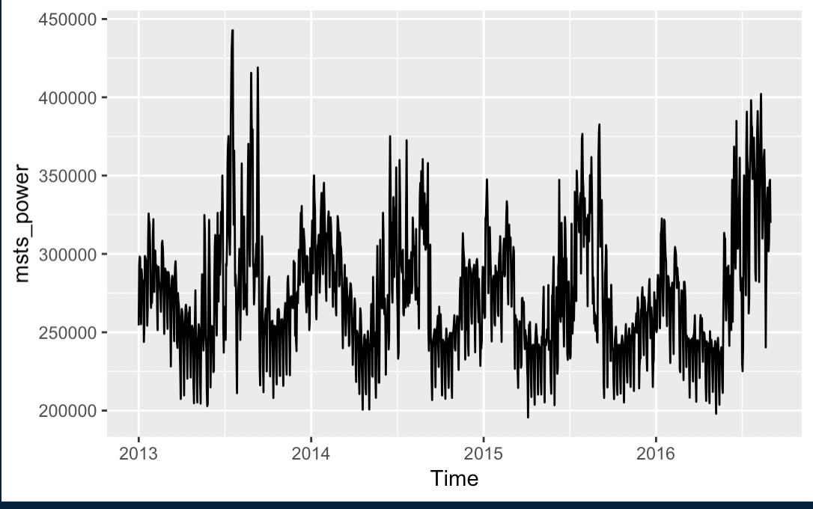
Temperature vs Power Consumption

Slide 9
Stationarity Test
Daily Data
Variables | ADF Test | KPSS Test | Differencing
Consumption | ✔ | ✔ | Yes
Temperature | ✔ | ✔ | Yes
Pressure | ✔ | ✔ | N/A
Wind Speed | ❌ | ❌ | Yes

Slide 10
Modelling

Slide 11
Models
Training Period - January 1, 2013 - August 31, 2016 (1,338 observations)
Test Period - September 1, 2016 - December 31, 2016 (122 observations)
Models
sNaive(Base Model)
TBATS
MSTL
Prophet
LSTM

Slide 12
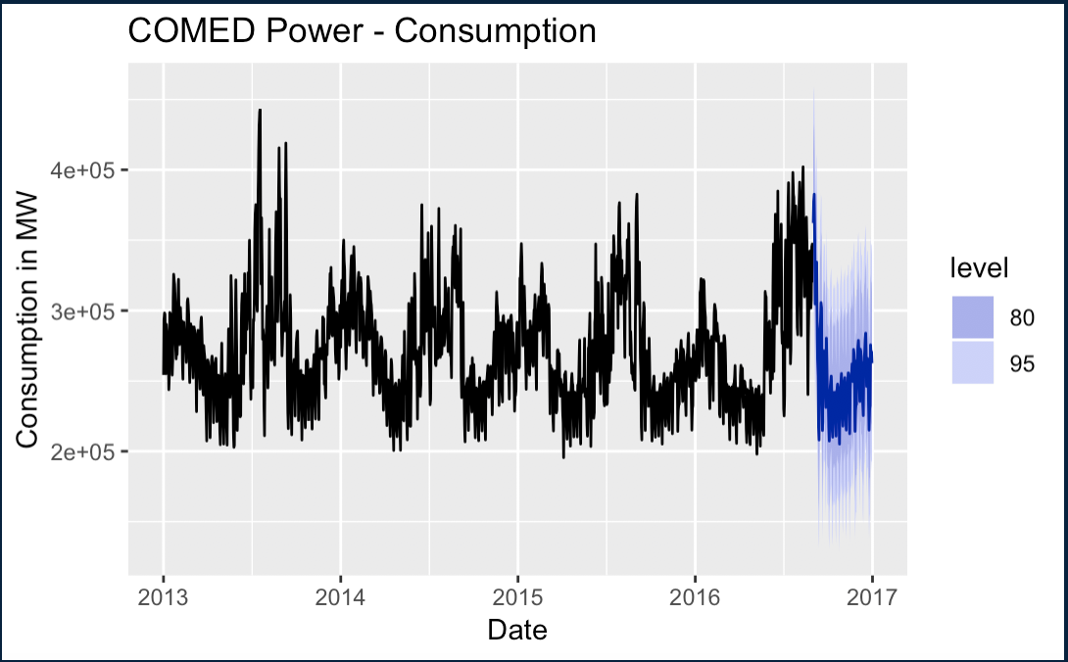
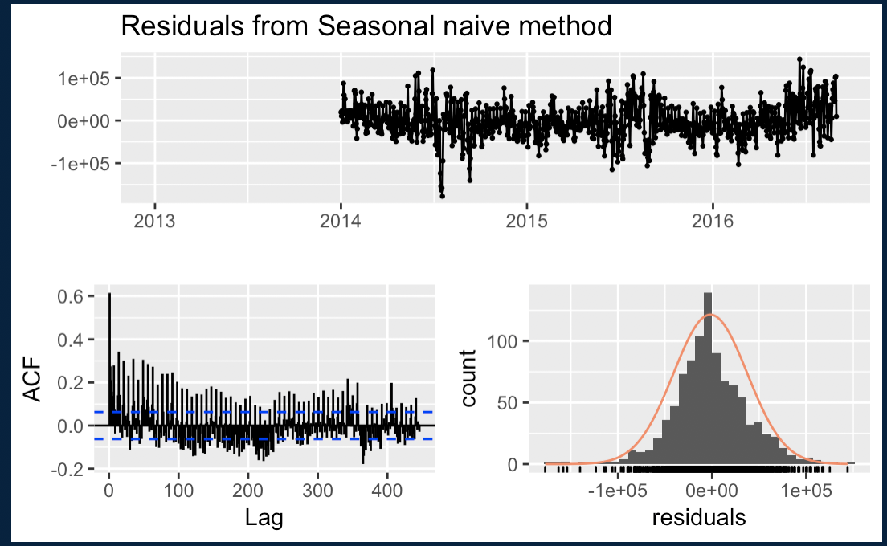
SNaive
Motivation: Obtain a simple baseline to compare with more advanced models

Slide 13
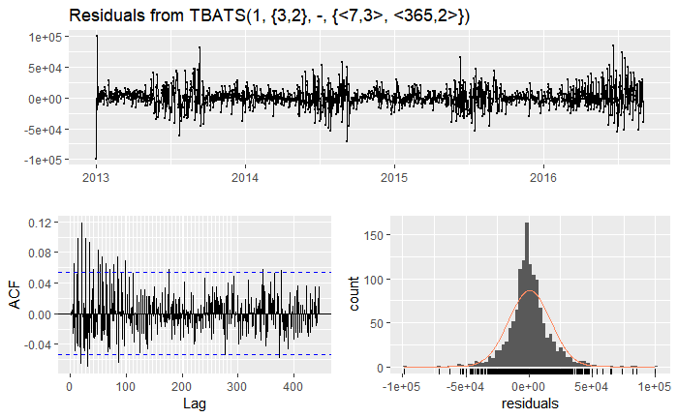
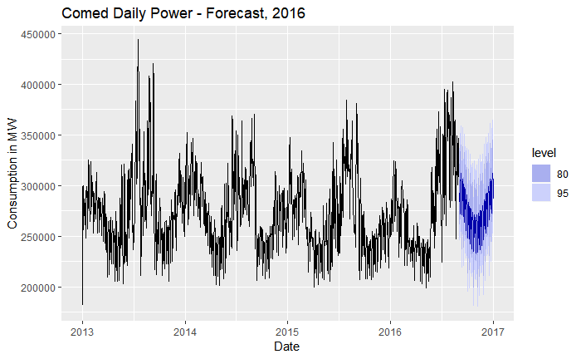
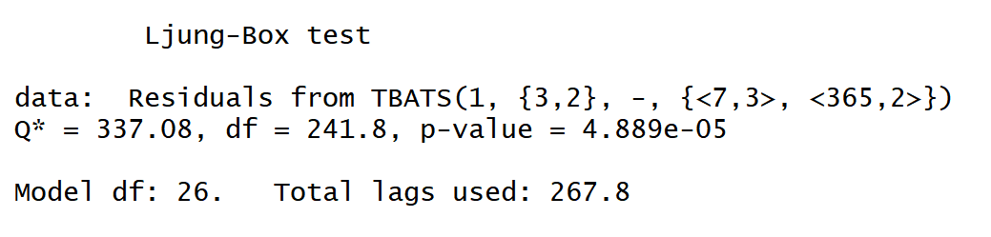
TBATS
Motivation : Use external regressors in the form of fourier terms to account for the seasonal behaviour
Notes:
As omega=1, no box.cox transformation
ARMA(3,2) is used to capture errors
Identifies weekly and yearly seasonality.

Slide 14
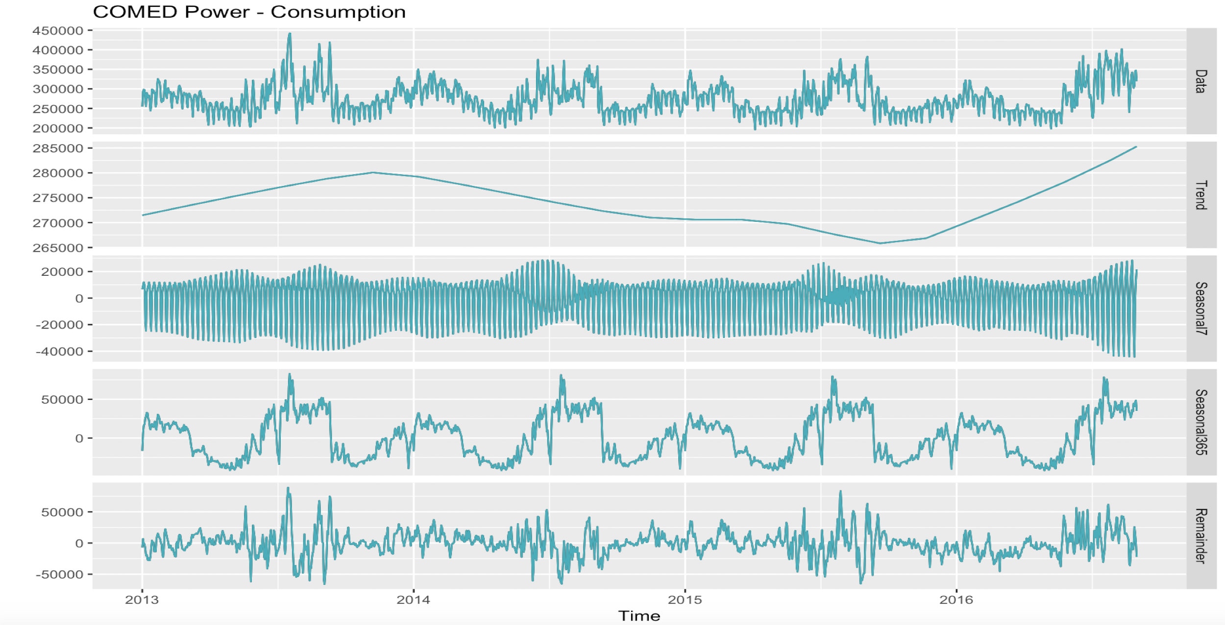
MSTL
Motivation: Forecast using trend and seasonality components of a decomposed series

Slide 15
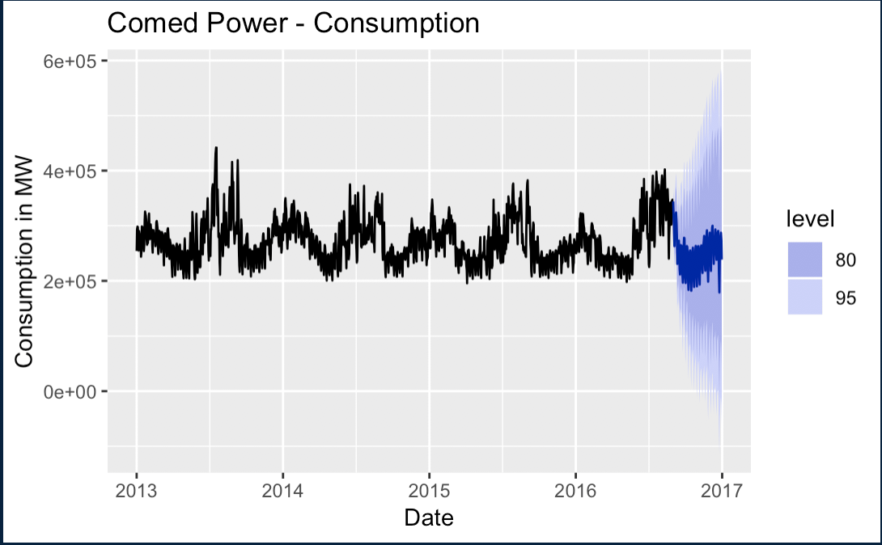
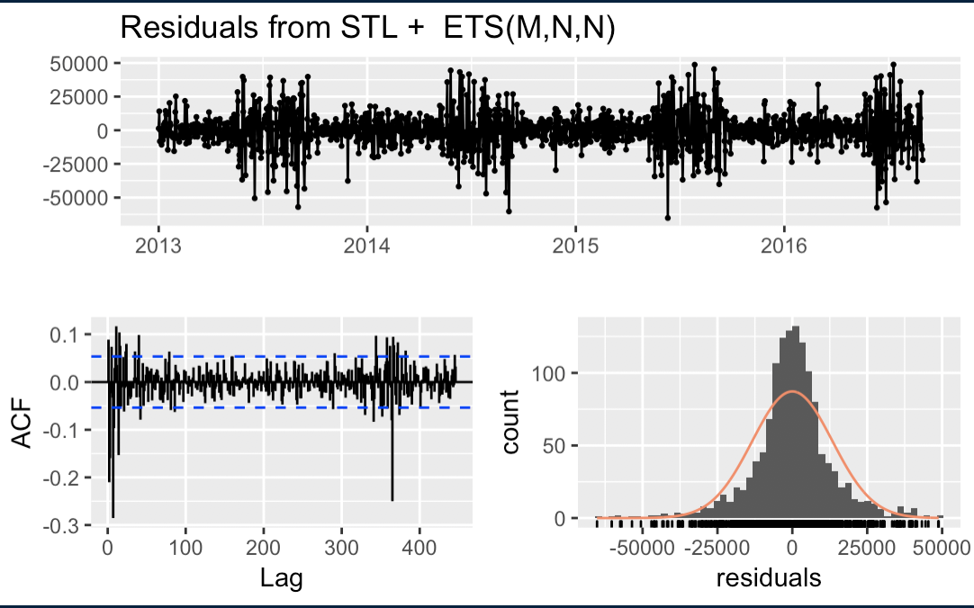
MSTL - Forecasting
Forecast using trend and seasonality components of a decomposed series

Slide 16
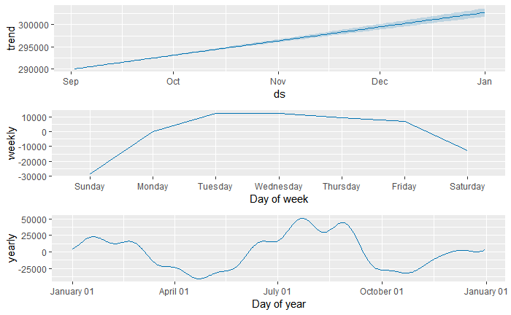
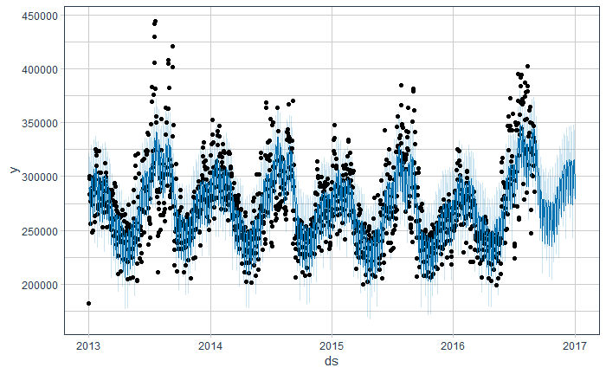
Prophet
Motivation: Forecast using trend and seasonality components of a decomposed series
Forecasting daily consumption

Slide 17
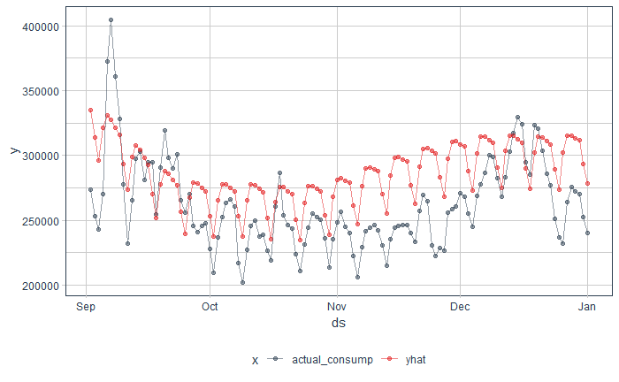
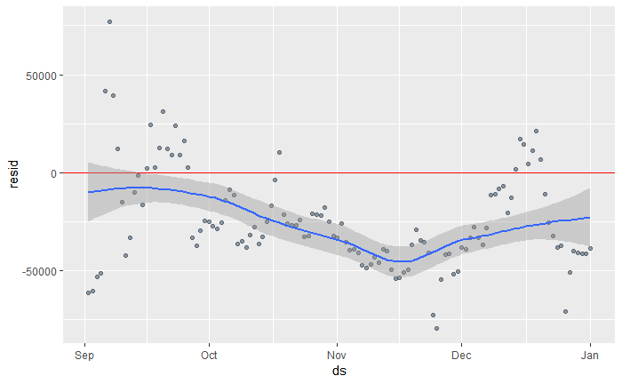
Prophet - Fit and residuals
Comparing actual vs predicted
Residual scatter plot

Slide 18
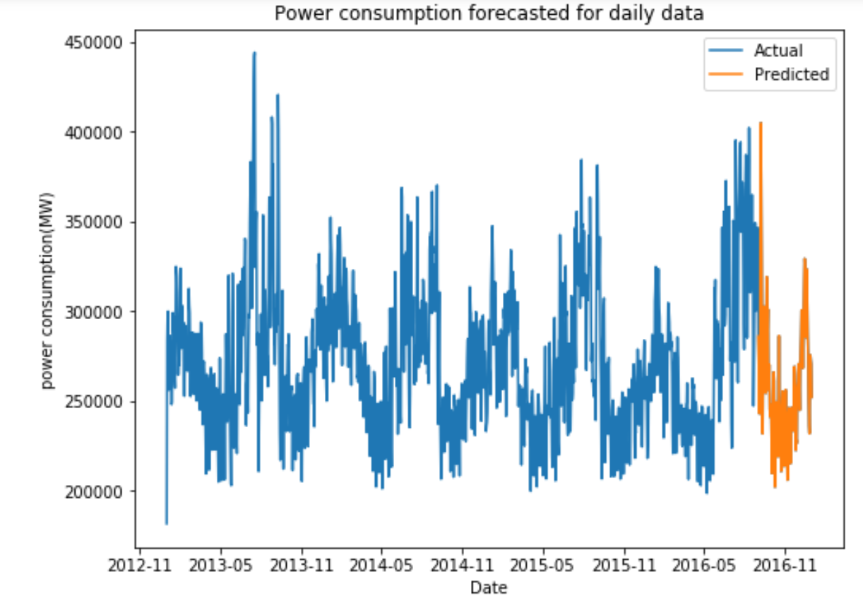
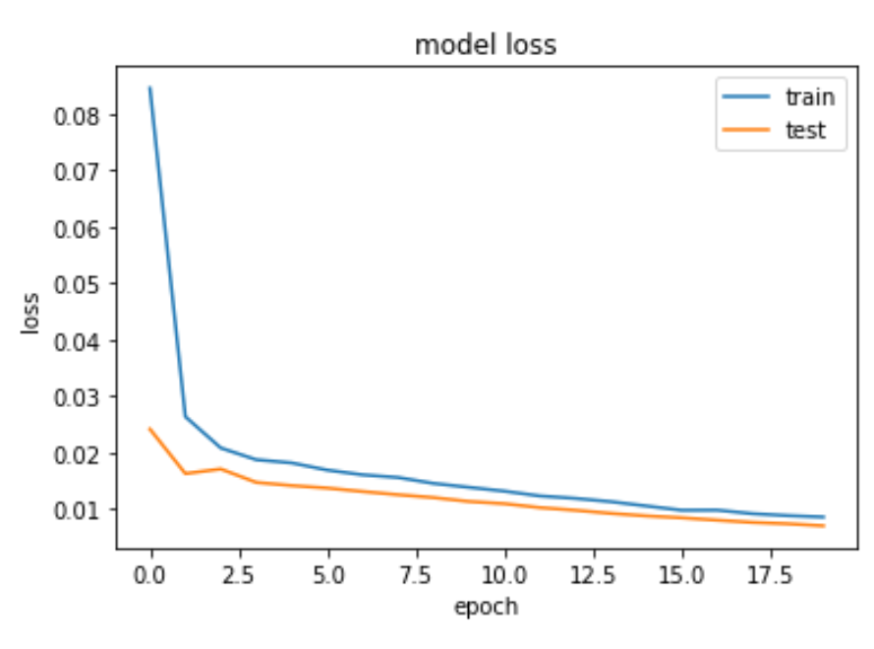
LSTM
Motivation: Ability to capture the trend and seasonality components robustly

Slide 19
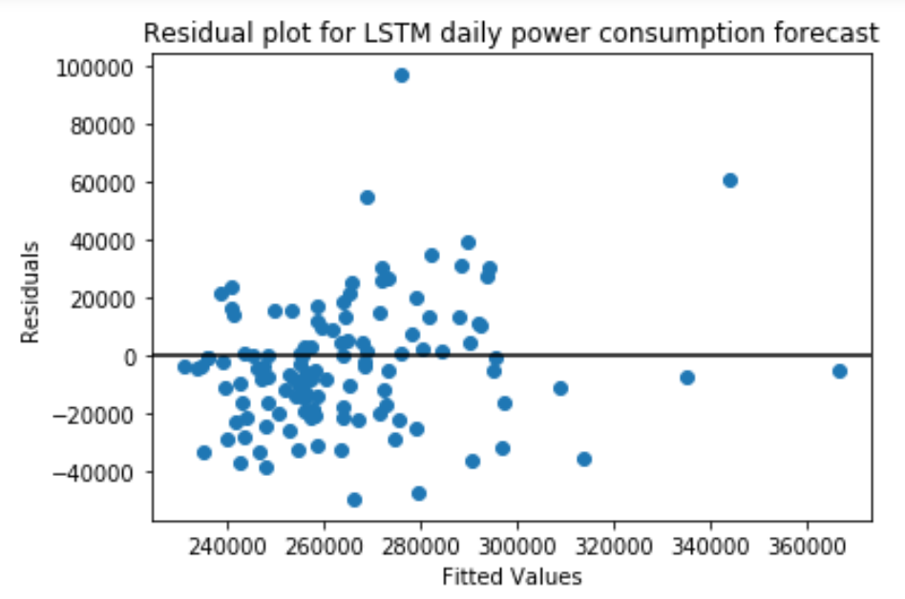
LSTM - Checking residuals

Slide 20
Model error metrics
Comparing the accuracy of the forecast of the various models
 | RMSE | MAE | sMAPE
sNaive | 37742.82 | 27652.02 | 0.104547
TBATS | 31364.05 | 26352.72 | 0.098317
MSTL | 28869.62 | 21889.76 | 0.083967
Prophet | 34854.51 | 30707.38 | 0.11368
LSTM | 22178.91 | 16780.54 | 0.063549

Slide 21
Conclusion
LSTM is the best performing model to forecast power consumption at a daily level
The model error metrics RMSE, MAE and sMAPE are the least
With better forecasting power ComEd will now be able to plan better and buy electricity effectively

Slide 22
Future Work
As we expect power consumption to be affected as holidays, including holiday information when building the forecasting model
VAR model can be used to leverage inter dependencies between the variables to provide more robust forecasts
Use a wider timeframe and windowing to train neural networks
Build hierarchical models to provide from a granular to a global insight

Slide 23
Thank You!

